Slide 1
OERs and open licensing: Why it matters to open universities?
Neil Butcher, OER Africa
October 2021

Slide 2
Covid-19 lockdowns have forced more content creators to make their work available on the Internet, but in a world of online information and knowledge, navigation and assessment of quality is becoming more difficult.
Acceleration of global problems (pandemic, climate change, food security, shifting employment due to 4IR, etc) requires international cooperation (supported by open knowledge networks) but there are growing signs of isolation and closure.
To be part of the knowledge economy and join the 4IR, we all need to be able to find the information we are looking for when we need it.

Slide 3
Open Educational Resources (OER) are teaching, learning and research materials in any medium – digital or otherwise – that reside in the public domain or have been released under an open license that permits no-cost access, use, adaptation and redistribution by others with no or limited restrictions. – UNESCO Open Access (OA) grants free and open online access to academic information, such as publications and data. OA publications allow anyone to read, download, copy, distribute, print, search for and search within the information, or use it in education or in any other way within the legal agreements at no cost to the user. – open access.nl

Slide 4
Open licences enable creators to make their work freely available for legal use, sharing, repurposing, and remixing.
Creative Commons licences provide an easy way to manage the copyright terms that attach automatically to all creative material under copyright.

Slide 5
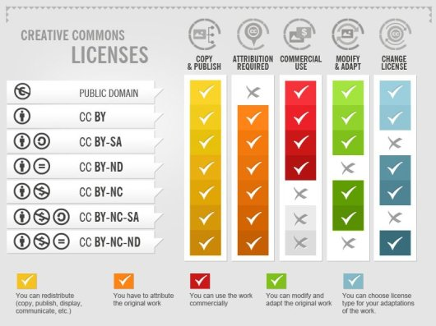
Creative Commons licences by Foter (CC BY-SA)

Slide 6
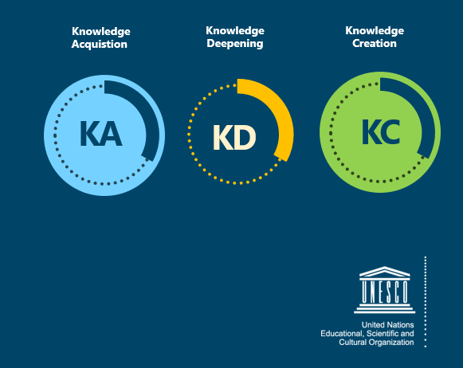
TPD – UNESCO ICT Competency Framework for Teachers (CFT)
Tool to guide pre- and in-service teacher training on ICT in education (CC BY)
Resources to teach educators to use OERs and create their own openly licensed content available on ICT CFT Hub
Adapted for use in multiple countries at national level
Available in English, Arabic, French

Slide 7
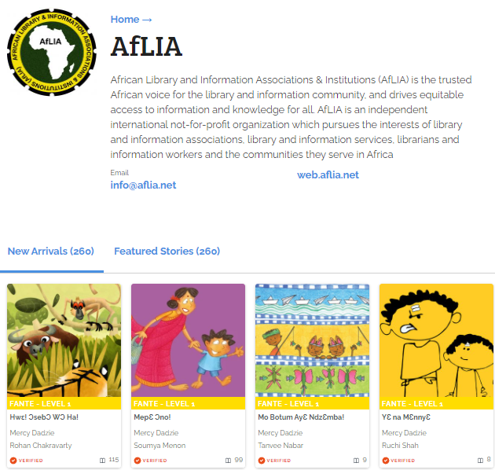
AfLIA won a StoryWeaver award to translate stories into African languages.
260 stories have been translated into numerous African languages.
AfLIA organized translation ‘hackathons’ to train language teams.

Slide 8
The role of librarians is more important than ever
Librarians are at the forefront of the knowledge economy:
Help users understand open licensing and IP issues
Enable user to navigate information to find what they are looking for
Assist with assessing quality of content
Guide users on how to adapt or repurpose content for their communities
Contribute to curating content and resources

Slide 9
OER can function as a catalyst, but the emphasis needs to be on:
Curriculum reform
Professional development
Change management
Developing countries as content producers

Slide 10
‘OER policies’ provide no guarantee of openness
Open licensing is not, by itself, a meaningful proxy for openness in education (improved access, better quality, greater success after studies, more flexibility, etc)
Open licensing can just as easily be deployed to entrench rigid, closed systems of education as it can help to create more open learning
Every policy decision we make should be measured against its real transformative effects on education

Slide 11
Open licensing allows wider access to knowledge and data. This can facilitate translation, repurposing into more accessible formats, and wider distribution, enabling more people to participate actively in the global knowledge economy.
Librarians are positioned to lead the way in the 4IR by helping their institutions and communities understand and harness the potential of open licences and OER.
OER Africa has developed a series of tutorials or ‘learning pathways’ to develop effective open educations practices while providing immediate access to relevant, useful skills and knowledge to understand open licensing.
Access the learning pathways at oerafrica.org

Slide 12
This work is licensed under a Creative Commons Attribution 4.0 International (CC BY 4.0) Licence https://creativecommons.org/licenses/

